Slide 1
Advanced html and css
Images
Tables
Forms
Audio and Video
Fonts and printing
Transitions and animations
V. Starkey
Computer Science & Engineering
Wright State University

Slide 2
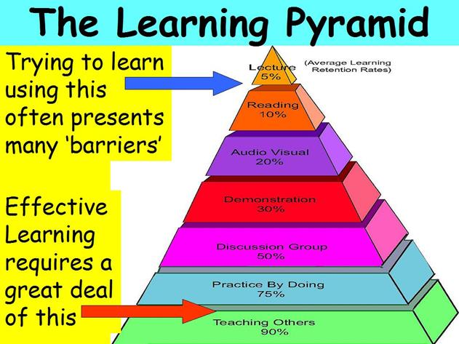
How we learn

Slide 3
Student-led lessons
Each table group will prepare the following materials for an assigned chapter.
A powerpoint presentation
An example web page or pages (html/css)
A short activity to be done in class
At least 10 exam questions (multiple choice/short answer) (word document; do not share during the presentation)
A list describing who did what within your group

Slide 4
Team captain
The team captain is responsible for ensuring that all materials, as listed on the previous slide, are uploaded to the group’s dropbox on Pilot.
Materials are due the day of your presentation.

Slide 5
Assessment – weeks 8-10
Lecture grade (MW of each week) – based on attendance/participation (completing the activity if applicable)
Homework October 27 – your group’s presentation will be used for this date’s homework grade
Homework due November 3 – short summary of key points from each chapter presented during week 9 (one paragraph per chapter); must be written in html
Homework due November 10 – short summary of key points from each chapter presented during week 10 (one paragraph per chapter); must be written in html

Slide 6
Exam topics
October 16 – lists and links (chapter 7)
October 23 – responsive design
October 30 – questions over October 26-28 presentations (online/take home)
November 6 – questions over November 2-6 presentations (online/take home)

Slide 7
Chapter assignments
Table 1 – Chapter 12 – Wednesday, October 28
Table 2 – Chapter 14 – Monday, November 2
Table 3 – Chapter 10 – Friday, October 30
Table 4 – Chapter 11 – Friday, November 6
Table 5 – Chapter 9 – Wednesday, November 4
Table 6 – Chapter 13 - Monday, October 26

Slide 8
Presentation dates
Monday, October 26 – Table 6 – Chapter 13
Wednesday, October 28 – Table 1 – Chapter 12
Friday, October 30 – Table 3 – Chapter 10
Monday, November 2 – Table 2 – Chapter 14
Wednesday, November 4 – Table 5 – Chapter 9
Friday, November 6 – Table 4 – Chapter 11

